Slide 1
Women in the Bible: Naomi and me
“Your word is lamp for my feet and a light for my path.”
Psalm 119:105
A Mentor
3
LESSON

Slide 2
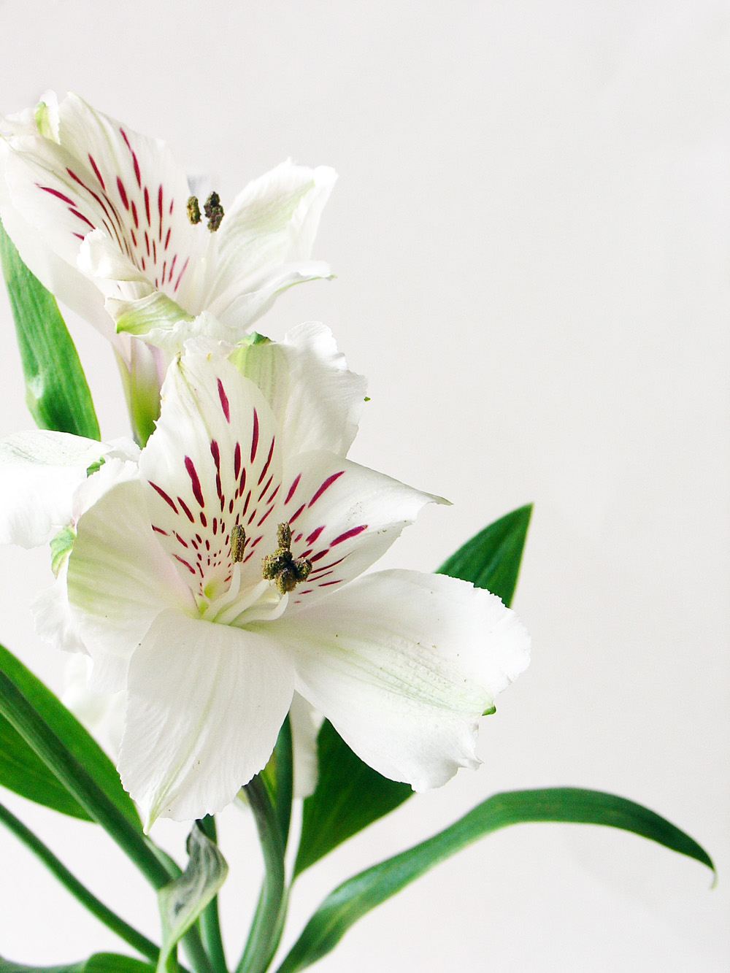
Naomi
Her Name Means “My Joy”
Key Scripture: The Book of Ruth
Introduction
God’s faithfulness in restoring to fullness an empty life is revealed more clearly in this story than in any other biblical account.
Naomi certainly had no idea of what was in store. On her return to Bethlehem, she asked the people to call her Mara, meaning “bitterness.” This gives us some idea of how she felt after her loss.

Slide 3
Naomi
Her Name Means “My Joy”
Like Naomi, we may at times have trouble recognizing God’s goodness and His faithfulness. But He is still with us, no matter what the circumstances.

Slide 4
Naomi
Her Name Means “My Joy”
Discover
* Her Joy
* Her Discouragement and Bitterness
* Her Wisdom

Slide 5
Naomi
Her Name Means “My Joy”
Going Deeper
Read the background story of Naomi and her family found in Ruth 1:1-5.
2. Alone and grieving, Naomi decided to go home to her native land. Who chose to go with her? (Ruth 1:6-7)
3. With Naomi’s encouragement, Orpah kissed her mother-in-law goodby and returned to Moab. (Ruth 1:8-15). How do you think Orpah felt as she left Naomi, whom she evidently loved?

Slide 6
Naomi
Her Name Means “My Joy”
4. Ruth chose to stay with Naomi, and her words of love are often repeated in wedding vows. However, these words of love were said by a daughter-in-law to her mother-in-law. (Ruth 1:16-17) What do these words suggest about the devotion between these two women?
Note: Ruth and Naomi returned to Bethlehem where they were greeted with excitement. But Naomi’s grief overflowed as she said, “The Almighty hath dealt very bitterly with me.” (Ruth 1:20). She had left Bethlehem with a husband and two sons and now was returning without the three most important people in her life.

Slide 7
Naomi
Her Name Means “My Joy”
5. What did Ruth suggest she could do to provide food for the two of them? How did Naomi encourage Ruth’s plan? (Ruth 2:2-3)
Note: As Ruth was gleaning in the fields, Boaz took note of her and instructed the men not to touch her and also to leave extra grain for her to glean. Boaz continued to show favoritism to Ruth and made certain that she went home with an ample supply of grain each evening. (Ruth 2:8-23)

Slide 8
Naomi
Her Name Means “My Joy”
6. Naomi then did something we probably would not expect of her. Perhaps she saw a glimmer of hope that their lives could become more secure and comfortable. She gave Ruth instructions as to how to approach Boaz at night. (Ruth 3:1-7) Although it seems unusual to us, given the customs of that time this was not an unusual approach.

Slide 9
Naomi
Her Name Means “My Joy”
7. What were the results of Naomi’s instructions to Ruth? (Ruth 3:7-15)
Note: A kinsman was a near relative. In that culture and time, the nearest kinsman was expected to buy back the land, or “redeem it.” Along with the land came the responsibility of providing for the women who were the heirs. Boaz approached the kinsman and asked if he wished to redeem the land. The kinsman agreed to do so, but when he found out it would include taking Ruth to be his wife, he decided against it. Boaz assumed the role of kinsman, redeemed the land, and made Ruth his wife. (Ruth 4:1-10)

Slide 10
Naomi
Her Name Means “My Joy”
8. What joyous event took place that lifted Naomi’s spirits? (Ruth 4:13-17)

Slide 11
Naomi
Her Name Means “My Joy”
Words for Today
9. What can I learn from Naomi that may help me to build a good relationship with my mother-in-law, daughter in-law, or other relative? How important is this?
10. What are three life skills I have learned that I can use to mentor others? As a mentor, who is one person I will support and encourage?

Slide 12
Naomi
Her Name Means “My Joy”
Questions for Discussion
Was it right for Naomi to say, “The Almighty hath dealt very bitterly with me”? Explain why, or why not.
2. Widows often say they feel “like a fifth wheel” in mixed social groups. Would it be best for them to fellowship mainly with other women who understand their problems? Explain.

Slide 13
Naomi
Her Name Means “My Joy”
Words of Wisdom
Naomi’s joy is the triumphal ending to one chapter of the story which goes on through succeeding generations. Ruth and Boaz’ son was Obed, who was the father of Jesse, who was the father of David and the ancestor of Jesus. Naomi was given the opportunity to help guide the ancestor of the coming Savior, Jesus Christ. Her joy was complete as she rejoiced over the filling of her life once more.

Slide 14
Naomi
Her Name Means “My Joy”
My Prayer for Today
Thank You, Father, for this illustration of the love that is possible between two generations. May I also be a mentor to the younger members of my family and always demonstrate your love.

Slide 15
Naomi
Her Name Means “My Joy”
Sharing
Do something nice to surprise your mother-in-law or daughter-in-law (or, if you have neither, for some other relative.)
In your circle of influence, be open to the possibilities of mentoring a younger woman in her Christian growth and, perhaps, her professional life.

